Slide 1

Mini Project Work-Phase 1 Review/21MP210
Project Review Presentation (50 Mks) – CIE
____ August 2022, First Year (2nd Semester)
Dayananda Sagar College of Engineering, Bangalore, Karnataka
Department of Electronics & Communication Engineering
Section : N
Smart floor cleaner
Mini Project Batch No : 18
USN : 1DS21EC053 (Sec-N) Name : Chandan Gupta
USN : 1DS21EC130 (Sec-N) Name : Nikhil kumar
Section Co-ordinator
Dr. Swapnil S N
Mini Project Guide
Prof. Deepa N P

Slide 2
Overview of the mini project phase-1 (CIE-1) presentation
Introduction
Literature Survey
Scope ,problem statement and Objectives
Methodology adopted with Block-Diagrams & Flow-Charts
H/w & S/w tools used
Implementation procedures carried out (h/w - s/w)
Results (experimentation or simulation)
Photographs of the hardware developed (if)
Advantages / Applications
Conclusions
Outcome of the project work
Flow of the future works (May’22 – Sep’22)
References used

Slide 3
Introduction to the mini-project (abstract) - highlights
In the current hectic schedule, cleaning houses and surrounding environment is more difficult and tiring. At present, there are floor cleaners which require humans to handle it. Thus, there is a need to implement floor cleaner which works without human intervention. An efficient method to clean the desired area has been implemented through this project. By using this floor cleaner, hazardous places can be cleaned which thereby reduce risks to mankind. This is achieved by implementing an autonomous system. Here, robotic car which is embedded with a floor cleaner is used. This system has an ultrasonic sensor attached to it, that helps in avoiding large obstacles such as tables, chairs, walls etc. By measuring the distance via this sensor, the car takes the direction where the distance between obstacle and car is more, hence avoiding the collision with the obstacles. The vacuum cleaner is designed with a fan. The entire system is run by batteries.

Slide 4
Literature Survey
Initially, floor cleaning is done by using hands or different handmade instruments. Such kind of cleaning requires a lot of humans afforts. As the dependency of human on technology increases, more and more products are launched for making human life easy. When electricity came into a role the concept of vacuum cleaner is introduced. Vacuum cleaners are constructed to clean any dry surface, this type of cleaning required very less application of muscle power. Then the concept of mobile robots is introduced. They are programmed in such a manner that they can move around in their environment. Currently, the market is occupied by various companies which are manufacturing such variety of robots. These floor cleaners are distinguished on the bases of their cleaning action such as dry cleaning or wet cleaning. Some of the major companies working in the field of automatic floor cleaners are Dyson, iRobot, Neato Robotics.

Slide 5
Scope,Problem Statement & Definition
Nowadays both Men’s and Women’s have their job profile, So it is difficult to maintain hygienic and clean places in house.
It is difficult to get ready for daily life routine and also to give time to house cleaning.
Over aged peoples which having lack of proper body functioning can’t clean their house need this.
Extreme requirement in medical hospital.
Large and big institutions where lack of workers can help for cleaning purpose.

Slide 6
Objectives of the mini-project work
An efficient method to clean the desired area has been implemented through this project. By using this floor cleaner, hazardous places can be cleaned which thereby reduce risks to mankind. This is achieved by implementing an autonomous system. Here, robotic car which is embedded with a vacuum cleaner is used.

Slide 7
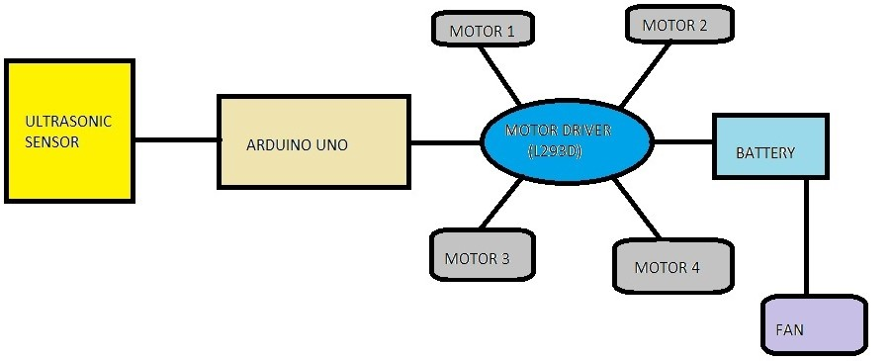
Methodology adopted with block-diagrams & flow-charts
Robotic car is built by using 4 DC motors they run with the speed provided in Arduino IDE code, it uses motor shield to work in desired speed and direction. Ultrasonic Sensor attached to car detects the distance at which obstacle is present in front of it. So, whenever it encounters any obstacles such as walls, tables or any big things that cannot be considered as garbage or dust. Car which carries floor cleaner changes its direction so that it won't crash and destroy itself. BLOCK DIAGRAM
fig:1 block diagram

Slide 8
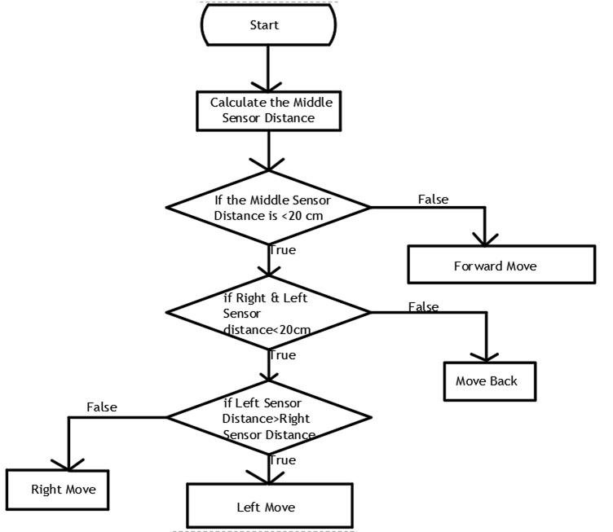
FLOW CHART
Fig:2 flow chart

Slide 9
Hardware & Software tools used in the mini-project
Hardware
Software
Arduino UNO
HC-SR04 sensor
Motor driver(L293D)
DC Motor(3V to 9V)
Servo Motor(5V)
Battery (18650)
Fan (12V)
Arduino IDE

Slide 10
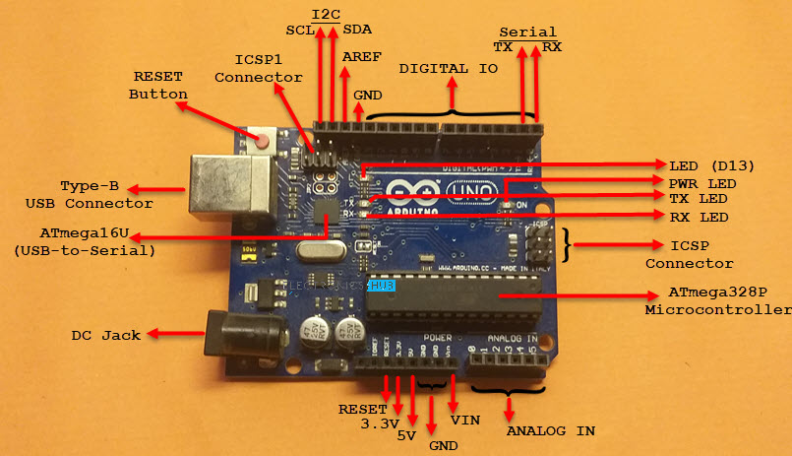
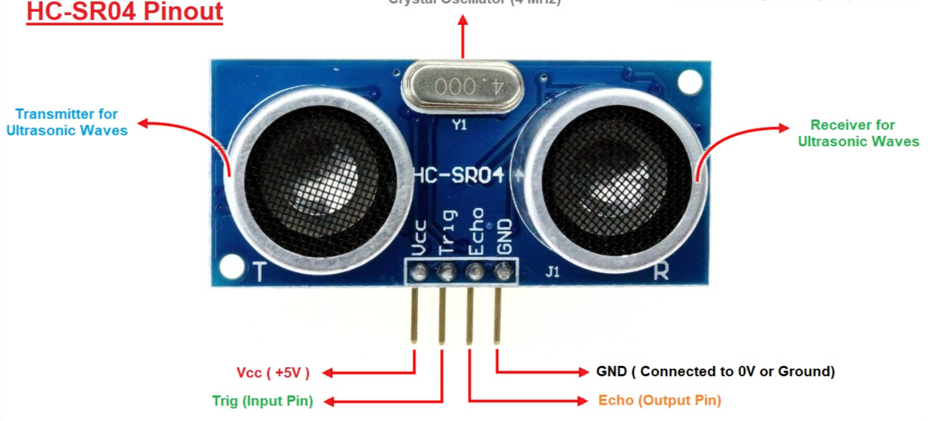
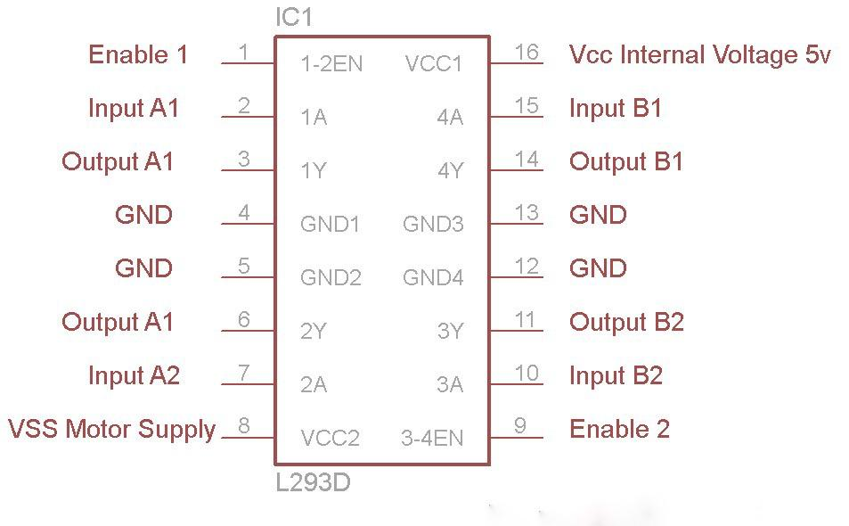
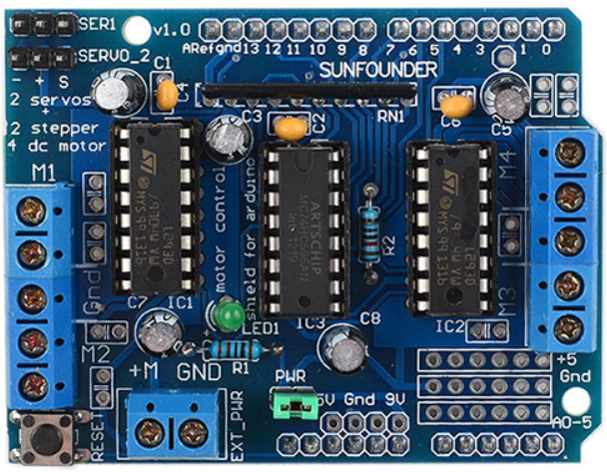
Fig:3 Arduino UNO
Fig:4 Ultra sonic sensor
Fig:5 L293B
Fig:6 Motor Shield

Slide 11
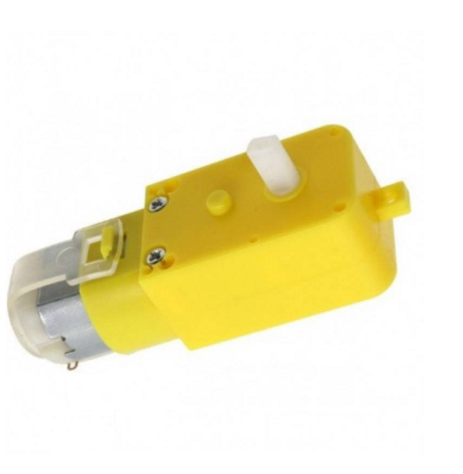
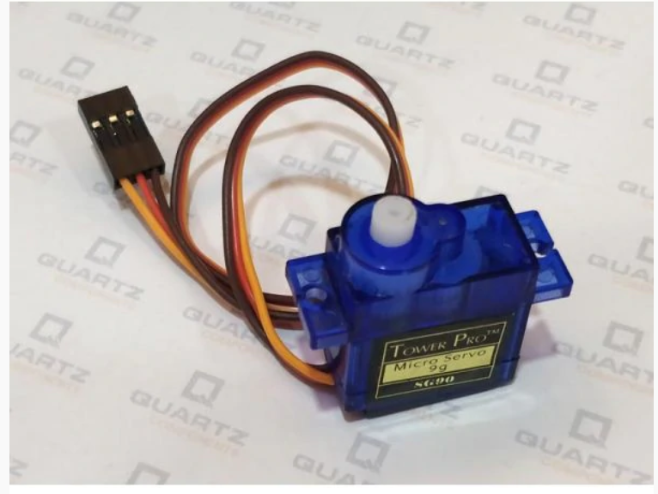
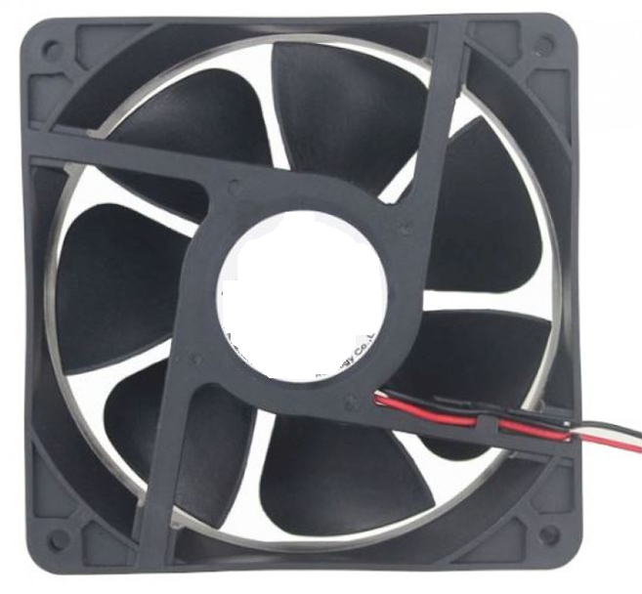
Fig:7 BO Motor
Fig:9 Servo Motor
Fig:8 DC Axial Fan

Slide 12
Implementation procedures carried out
We attached motor and wheel to the chassis
This mobile robot uses four dc motors, two for each side of the platform. Each motor is programmed individually and can move the robot in any direction
The robot uses HC-SR04 ultrasonic sensor to measure the distance between the robot and the obstacle.
We put the ultrasonic sensor on the servo motor so that the sensor can rotate
We mount L293D motor shield on Arduino and connect motor wire in Arduino.
We use DC axial fan (12V) for making vaccum cleaner.
For connection between all the component, we uses jumper wire and 18650 battery to give power to the Arduino.

Slide 13
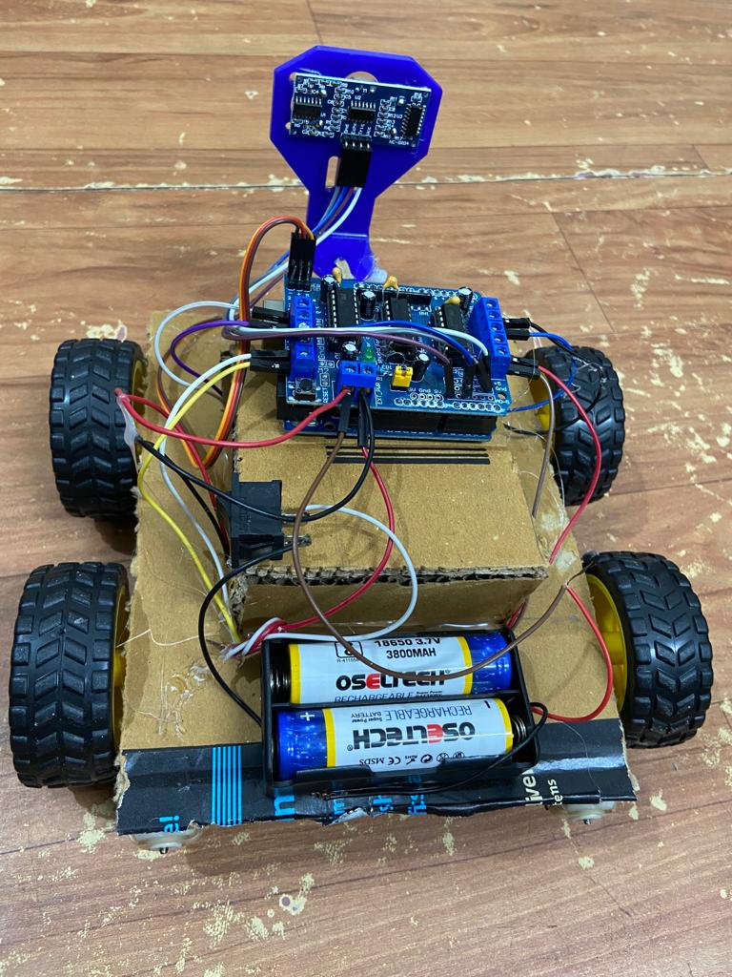
Results (experimentation or simulation)
The robot (smart floor cleaner) is successfully made to move making an obstacle free path and wherever it goes, it will clean the floor without coinciding with the object coming in its path.
Fig:10

Slide 14
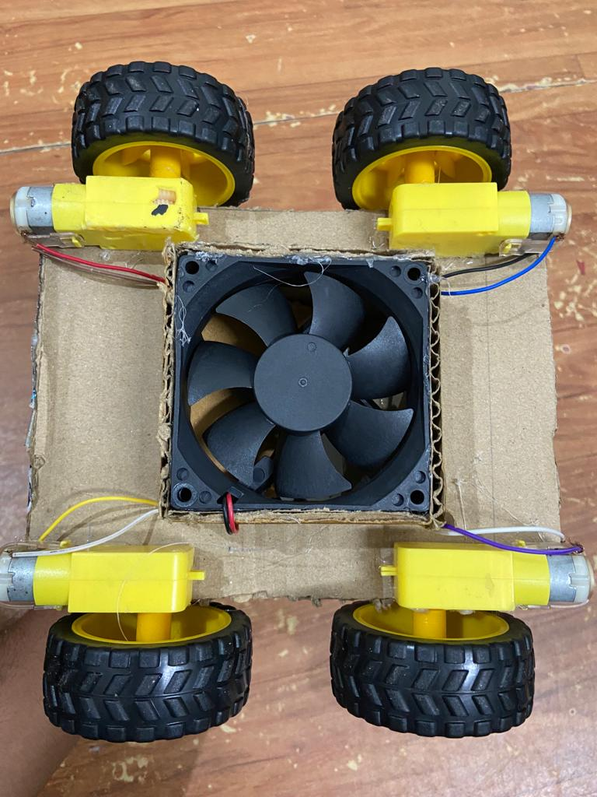
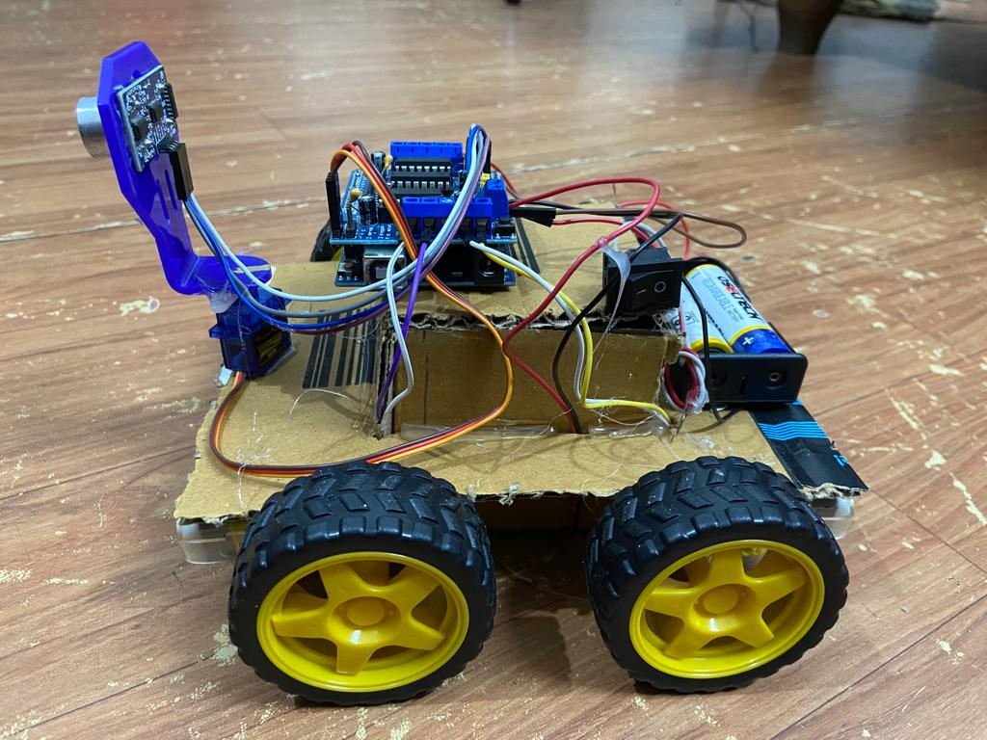
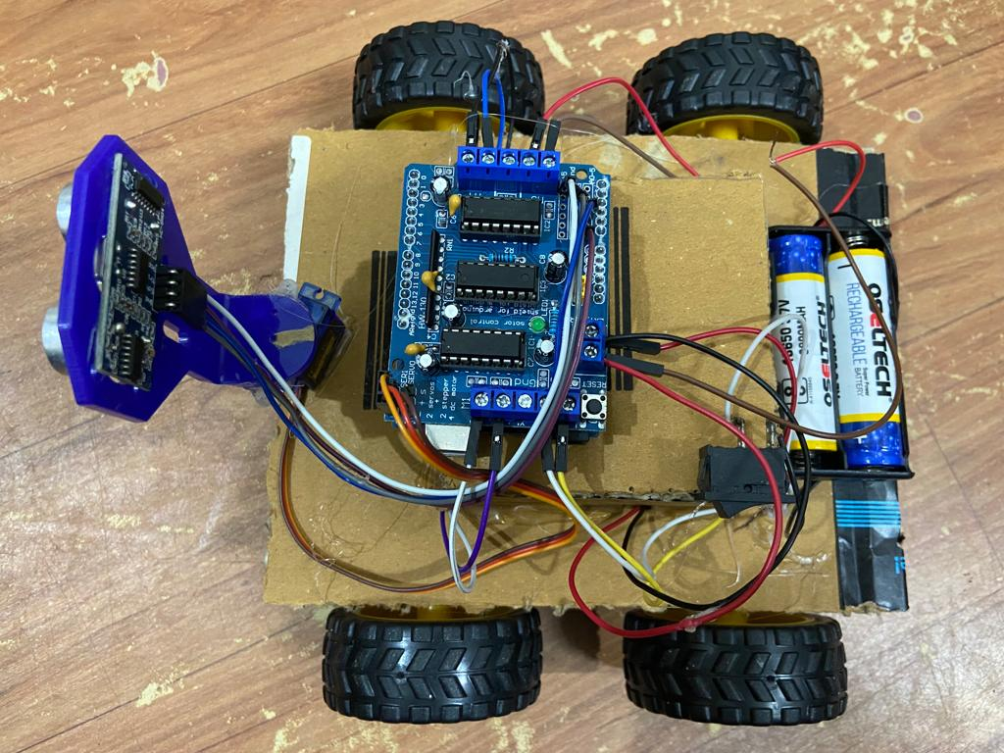
Photographs of the hardware developed
Fig:12
Fig:11
Fig:13

Slide 15
Advantages / Applications
They are majorly used to remove dirt and dust from the floor without any collision.
Compact in size and easy to store.
By using this vacuum cleaner, hazardous places can be cleaned which thereby reduce risks to mankind.
It will clean the floor without human interference.
With sensor, it can not only prevent itself from being damaged but also can avoid damaging the furniture. It can also detect walls and stairs and will automatically turn around when it comes across either one.

Slide 16
Conclusions and future work of the mini-project work
In this project Smart Floor Cleaner has been implemented. It is working on a pre-defined code inserted in Arduino UNO. Whenever car encounters any obstacle, it turns to the side where the distance between obstacle and car is more. This project helps collect the dust using a vacuum cleaner made using DC axial fan and batteries without human intervention thereby reducing the hazards to human health. This is a simple and cost-effective cleaner. However, using a detachable bag may be better as removing the dust becomes simpler.

Slide 17
Outcome of the mini-project work
The result is obtained for smart floor cleaner using Arduino, the system is able to remove dirt and dust from the floor effectively by avoiding large obstacles such as tables, chairs, walls etc.
If the robot moves forward if any obstacle detect it check for other directions and moves where there is no obstacles it moves in forward direction, to sense the obstacle ultrasonic sensor is used. We used servo motor to rotate the ultrasonic sensor.

Slide 18
Flow of the mini-project works (May’22 – Sep’22)
May-2022
Jun-2022
Jul-2022
Aug-2022
Sep-2022

Slide 19
References Used
https://www.youtube.com/watch?v=hHIIWpZcYNs&ab_channel=Rizwan%27sIdeas
https://en.wikipedia.org/wiki/Arduino_Uno
https://www.rakeshmondal.info/L293D-Motor-Driver
https://github-wiki-see.page/m/sezgingul/Obstacle-Avoiding-Robot-Library/wiki/Circuit-Design

Slide 20


?
?
Questions

